Slide 1
Where Do The Robots Drive?
Demaria C. - Galvagni G. - Piacenti E.
Notes:
Good Morning, I’m Gianluca Galvagni and I'm here with two my colleagues. “ … “ We browsed on Kaggle and found the problem “Where do the robots drive?’.

Slide 2

Table of Contents - Introduction
The Problem
Introduction to the problem
Input - Dataset
Preprocessing Dataset
First Solution
Random Forest
Implementation RF
Second Solution
Neural Network
Implementation NN
Conclusion
Comparison & Results
Notes:
Our submission through a detailed analysis of the problem, the models decided to use and the comparison between of these processes. Here you can see what we are going to speak about.

Slide 3
THE PROBLEM
Notes:
I’m going to introduce the problem briefly

Slide 4

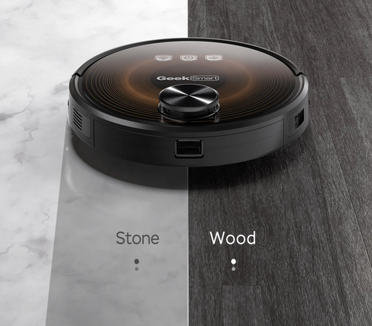
Introduction to the Problem
One of the key challenges in the robotic is enabling robots to discern and adapt to different types of floor surfaces they encounter.
Our goal is to equip robots with the intelligence to discern the nature of the floor surface they're standing on using data collected from Inertial Measurement Units (IMU) sensors.
Notes:
In the robotics navigation diverse environments are always more likely. One of the key challenges in this domain is enabling robots to discern and adapt to different types of floor surfaces.
To address this challenge, our goal is to equip robots with the intelligence to discern the nature of the floor surface. In this case, they’re using data collected from the Inertial Measurement Units (IMU) sensor.

Slide 5
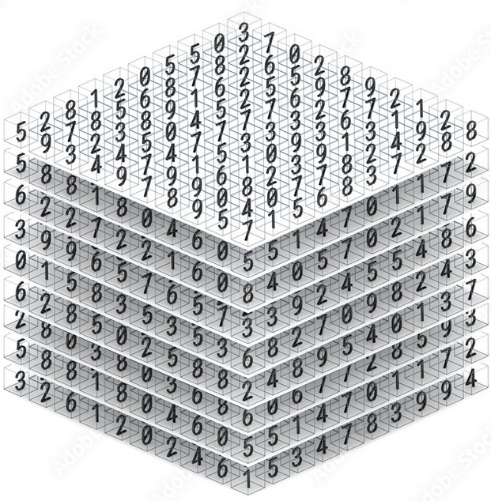

Input - Dataset
We use three datasets X_train and Y_train..
These data are collected driving a small mobile robot over different floor surface.
The datasets include ID columns that serve as identifiers for each row.
Notes:
By analyzing the IMU sensor data gathered while traversing various floor surfaces, we aim to build predictive models capable of accurately classifying each surface type. So, we downloaded the datasets and started to understand the data.

Slide 6
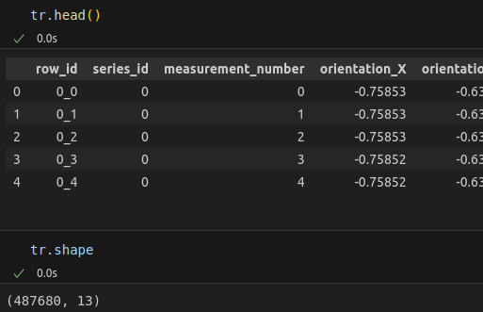
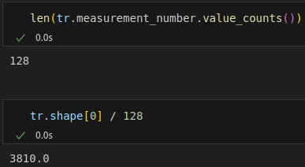
X_train
This dataset with measurements from 10 sensor channels, each with 128 measurements per series.
Series and measurements identifiers → row_id, series_id and measurement_number.
measurement orientations → (X, Y, Z, W)
angular velocities and linear accelerations → (X, Y, Z)
Notes:
X_train is the effective measurements from the sensor and you can see the shape of it and how the first five lines are composed. It has the series and measurement identifiers and the starting measurements orientation and so on.

Slide 7
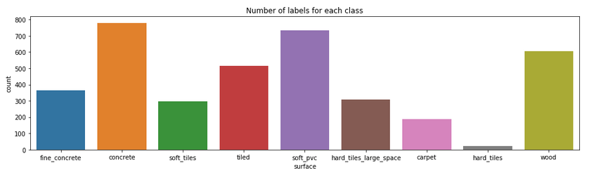
Y_train
Series_id → this corresponds to the series in train data.
Group_id → special numbers fixed for different surfaces.
Surface → is the surface type that need to be predicted. We have 9 different surfaces.
Notes:
In the plot you can see the total number of different test did for building the datasets, there are NINE different surfaces. Y_train is connected with the X_train data with the correspective surface using the serie_ids. In this problem we will work with a multi class classification problem.

Slide 8
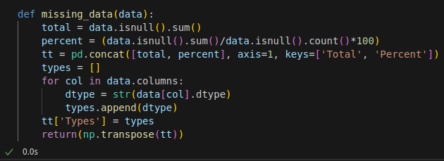
Preprocessing Dataset
We browse the datasets checking for missing value using the function “missing_data(data)”.
The datasets were without missing value.
Notes:
We started to preprocessing the datasets with the missing_data function. This function provides a convenient way to quickly analyze missing data and understand the distribution of missing values across columns.

Slide 9
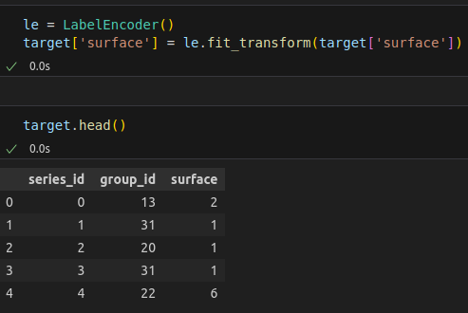
Preprocessing Dataset
And then we used the ‘LabelEncoder()’ class to convert categorical labels into numerical labels.
Notes:
Then, we used the ‘LabelEncoder’ class to transform the values of the ‘surface’ column into numerical labels. This transformation is useful for working with machine learning algorithms that require numerical input instead a categorical data.

Slide 10
FIRST SOLUTION:
RANDOM FOREST
Notes:
We decided to use the Random Forest Classifier for it’s capability to process multi class classification and to have an interpretability of the dataset.

Slide 11
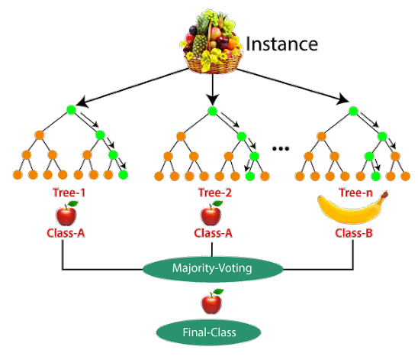
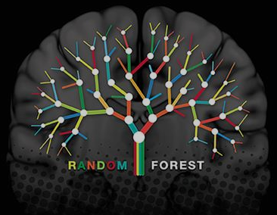
Random Forest Classifier
The Random Forest Classifier operates by constructing a multitude of decision trees during training and outputting the mode of the classes as the prediction of the individual trees.
It combines multiple decision trees to improve predictive accuracy and control overfitting.
Notes:
Random Forest is a machine learning algorithm that is used for classification tasks. It is an ensemble method that combines multiple decision trees to make a more accurate and robust prediction. In a random Forest, a large number of decision trees are constructed on different subsets of the dataset. Each decision tree is constructed by randomly selecting a subset of features and a subset of data points from the original data set.

Slide 12
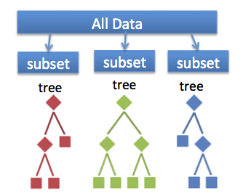
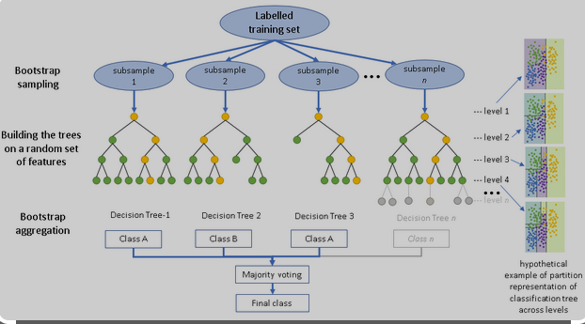
Random Forest Classifier
Bagging → Create multiple datasets for training each decision tree. This involves randomly sampling the training data with replacement to create different subsets. Each decision tree is then trained on one of these subsets.
For classification tasks each decision tree in the forest independently predicts the class, and the final prediction is determined by a majority vote among all the trees.
Notes:
During the training process, each decision tree is trained independently on its own subset of the data. Once all the trees are trained, they are combined to make a final prediction. The final prediction is made by taking the majority vote of all the individual tree predictions.

Slide 13
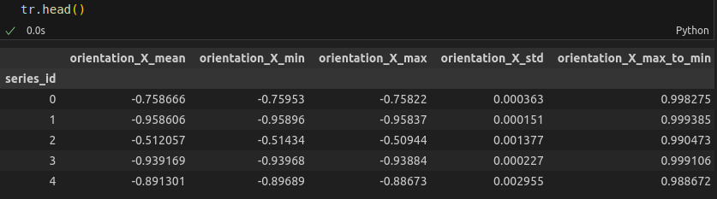
Feature Engineering for the Data
Computing statistical measures such as mean, standard deviation, min-max values. We can capture different aspects of the data that are important for distinguishing between different classes.
Notes:
Feature engineering plays a crucial role in preparing data for machine learning. By extracting relevant features from X_train data, we want to improve the efficiency, performance and interpretability of the model. Random Forest uses these input data to make the prediction so, by providing a diverse set of features that capture different aspects of the sensor data.
To sum up, we added many information for any TEN channels and a comparison between the velocities because the dataset was unbalanced, that means classes were big different cardinality so we did this process to compensate these different.

Slide 14
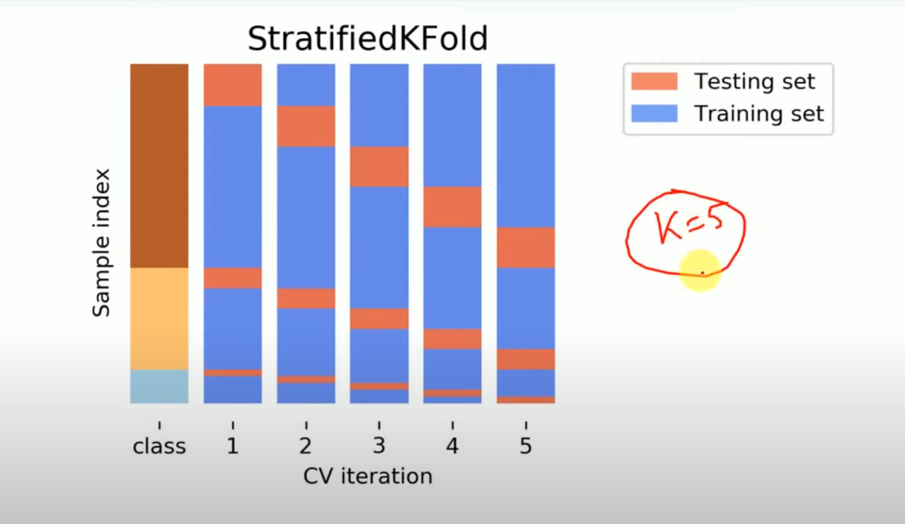
Stratified-K-fold
The goal is to maintain the original class distribution in each fold.
Helps to address issues in datasets with uneven class frequencies.
Provides a more reliable assessment of model performance
Increases the model's ability to generalize to unseen data.
Especially useful in classification tasks.
Notes:
To evaluate the model's performance robustly, we have decided to employ Stratified K-Fold cross-validation. As you can see from the image on the left, The StratifiedKFold technique ensures that each fold maintains the same distribution of target classes as the original dataset.
Why is that? Well, this is particularly crucial when dealing with imbalanced datasets, such as in our problem, as it ensures that each surface type is represented proportionally in both training and validation sets.
The choice that we have made of 5 folds is, actually, to find a balance between computational efficiency and , at the same time, obtaining a reliable estimate of the model's performance.
So, We will iterate through each of the folds to systematically train and evaluate the model multiple times on different subsets of the dataset.

Slide 15
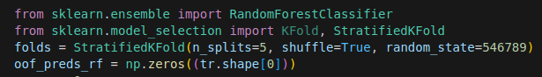
Implementing Cross-Validation
Stratified K-Fold Cross-Validation is used to ensure balanced class distribution in each fold, critical for imbalanced datasets
Notes:
The initial setup involves creating a StratifiedKFold object, configured with five splits for cross-validation
The introduction of a random seed (546789) ensures reproducibility, a crucial aspect in scientific experiments
(During each iteration of the cross-validation loop, a subset of the data is used for training, and a different subset is used for validation.)
oof_preds_rf stores the model's predictions on the validation set for each fold, meaning predictions are made on the data points that were not part of the training set for that specific fold.
The key idea is that by collecting predictions on out-of-fold data for each fold, you obtain a set of predictions that cover the entire dataset without using any data for training more than once.
This allows for a comprehensive evaluation of the model's performance across the entire dataset, providing a more reliable estimate of how well the model generalizes to unseen data.

Slide 16
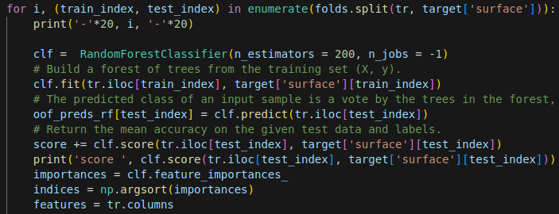
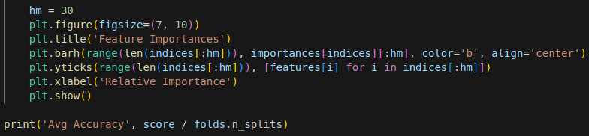
Implementation Random Forest
Notes:
The RandomForestClassifier is configured with essential hyperparameters. The
number of estimators (trees) is set to 200, a common heuristic choice for balancing accuracy and computational efficiency.
The 'n_jobs' parameter is set to -1, allowing the algorithm to use all available CPU cores for parallel processing and speeding up model training.
# First of all we train the classifier on the training subset using clf.fit
clf.fit(tr.iloc[train_index], target['surface'][train_index])
# the we predict the labels for the test subset
oof_preds_rf[test_index] = clf.predict(tr.iloc[test_index])
# below, instead, we calculate and accumulate the accuracy score on the test set
score += clf.score(tr.iloc[test_index], target['surface'][test_index])
# Printing the accuracy score for the current fold we are in
print('score ', clf.score(tr.iloc[test_index], target['surface'][test_index]))
[next slide]
eventually, Accuracy scores for each fold are printed, providing insights into model performance on varied data partitions.
Feature importances are calculated, and a plot is generated to visualize the relative importance of different features.

Slide 17
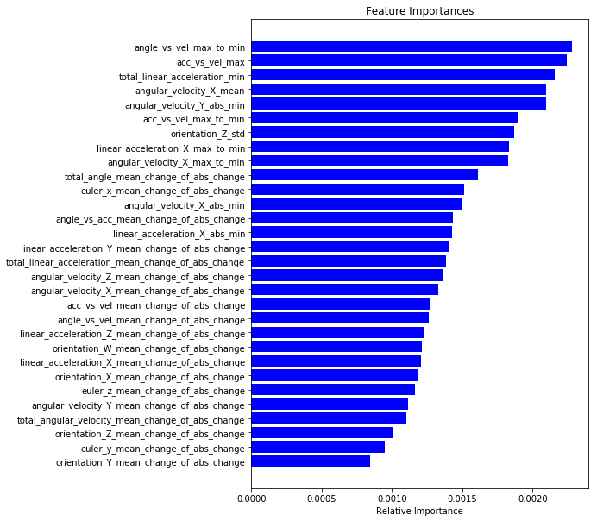
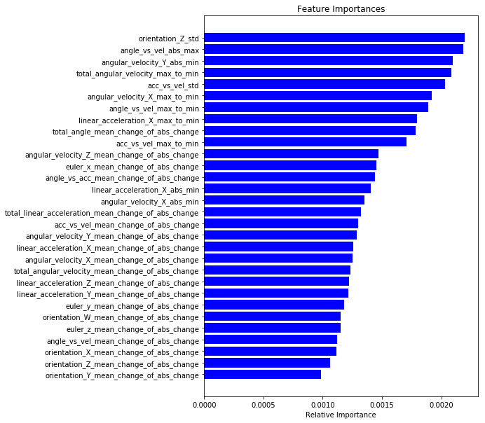
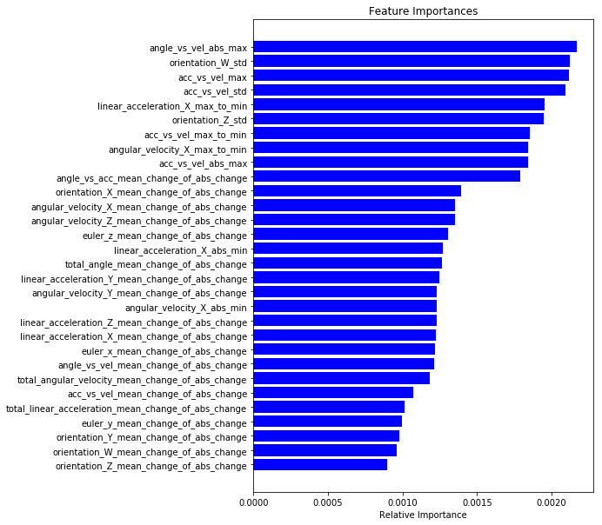
Plot Feature importances
Notes:
Feature importances help identify which features have a more significant impact on the model's predictions. This can provide insights into the underlying patterns and relationships in the data.
If multiple features are highly correlated, their importances might be distributed. Visual inspection can help identify such redundancies and guide feature engineering.
Higher importance values indicate a more substantial contribution to the model's predictions compared to features with lower values.

Slide 18
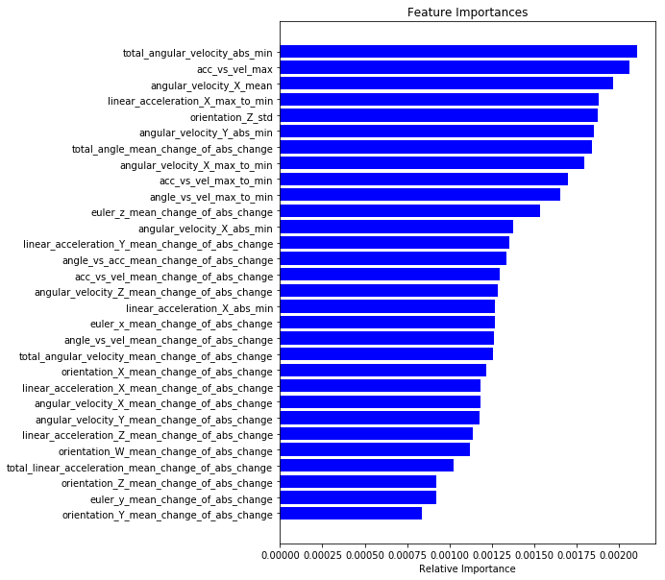
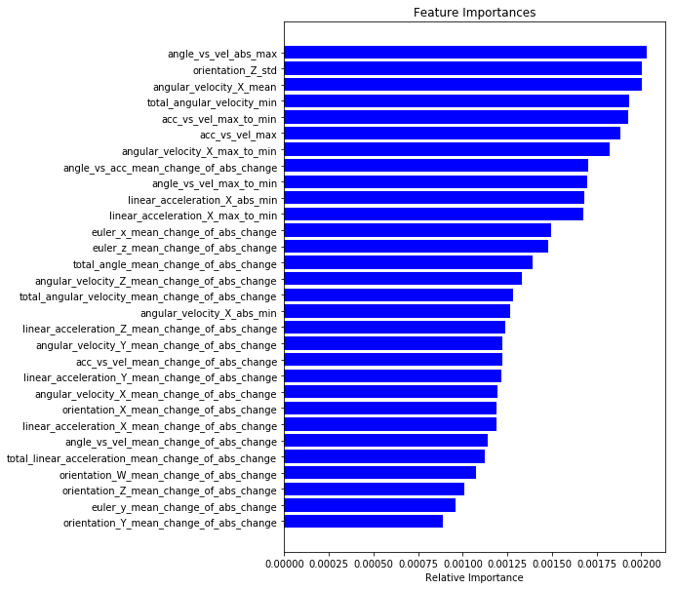
Plot Feature importances
Average accuracy:
0.9075829271149992
Notes:
- the value on the right provides an overall estimate of the model's performance across different subsets of the dataset, considering the variations introduced by the cross-validation process. A high score like the one that we have achieved suggests that the model is fitting the training data well.

Slide 19
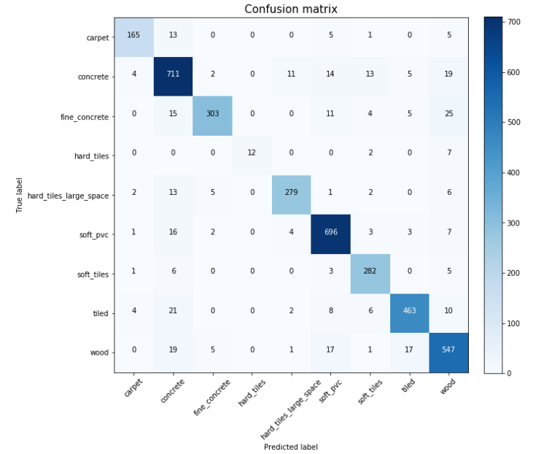
Evaluation of performances: Confusion Matrix
Assess the performance of a classification model
Understand where the model excels and where it tends to make errors.
Evaluate how well the model performs on each class, particularly in the context of varying class sizes.
Notes:
Given oof_preds_ref, we can build a confusion matrix. A confusion matrix is a table used to evaluate the performance of a classification algorithm. It provides a summary of the predictions made by a model compared to the actual ground truth. The matrix is particularly useful when dealing with multi-class classification problems
-X-axis (Columns): Represents the predicted classes. Y-axis (Rows): Represents the actual (ground truth) classes.

Slide 20
SECOND SOLUTION:
NEURAL NETWORK
Notes:
For the second model, we decide to use an Neural Network Classifier because it can use without doing a strong work on the dataset differently what we have did for the Random Forest. So we want to compare these two different approaches if there is a big different.

Slide 21
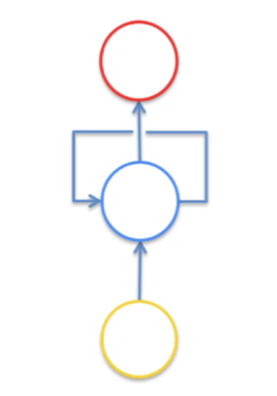
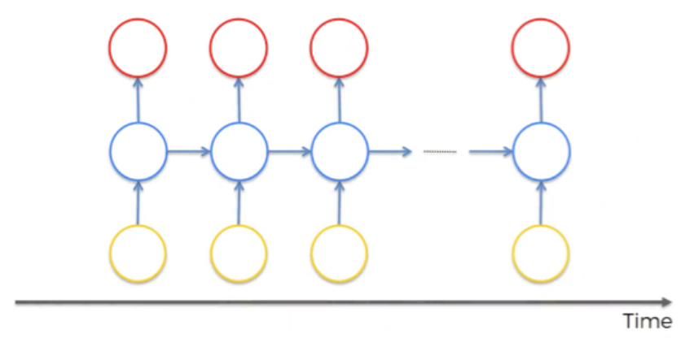
Neural Networks for time series data:
Recurrent Neural Networks
Neurons have some sort of short-term memory providing them with the possibility to remember what was in this neuron just previously;
Neurons are also connected to themselves through time: they can pass information on to themselves in the future and analyze things;
Notes:
first of all we analyse the dataset: our dataset consists in 10 sensor channels and 128 measurements per time series, it means that each sequence of measurements is a time series.
This time series classification is closely connected to recurrent neural networks (RNNs),
(slide)

Slide 22
Vanishing Gradient Problem:
LSTM networks
During the training phase, we backpropagate the gradients with the weights of every single neuron that participated in the calculation of the output;
When backpropagation through time, gradients are multiplied by these weights repeatedly: when you multiply something by a small number, your value decreases very quickly;
Weights associated with earlier time steps are updated much slower than the weights associated with later time steps;
Domino effect: the weights of the “earlier time steps” define the inputs to the “later time steps” layers;
The lower the gradient is, the harder it is for the network to update the weights and the longer it takes to get to the final result.
Notes:
The behaviour of Recurrent Neural Networks emphasizes a problem related to neural networks in general that we have seen during the deep learning part of the course: Gradient Vanishing problem
just to introduce the concept
backpropagating the gradients with the weights of every single neurons, we multiply the gradients by these weights repeatedly with the risk (if the weights are small numbers) that the gradient decreases very quickly
The lower the gradient is, the harder it is for the network to update the weights and to get to the final result

Slide 23
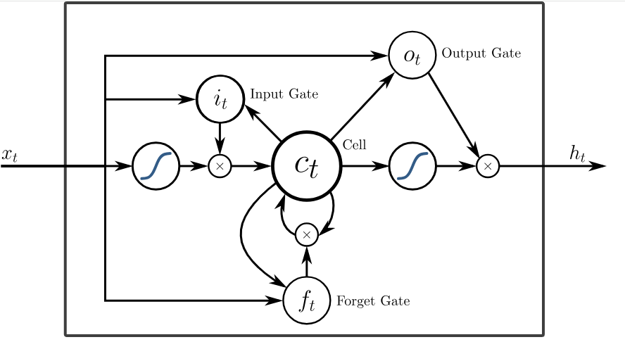
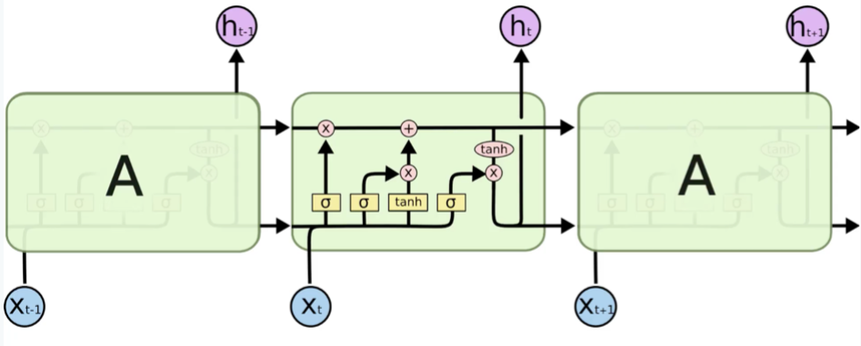
Long Short-Term Memory networks
LSTM networks are specifically designed to address the vanishing gradient problem and capture long-term dependencies more effectively in recurrent neural networks.
LSTMs incorporate gate mechanisms to regulate the flow of information through the network: input, forget and output gates.
LSTMs include a memory cell that can maintain information over long sequences. The memory cell allows the network to retain relevant information and selectively update it over time.
Notes:
so our choice are Long short term memory networks that are recurrent neural networks that incorporate gate mechanisms to regulate flow of information through the layers and so are specifically designed to address the vanishing gradient problem
so we have a memory cell and three gate, and the neurons can remember what was in the neuron just previously and decide how much this information influence the next value of the neuron itself, using sigmoid activation function and hyperbolic tangent activation function.

Slide 24

Implementation: Libraries
Pandas for managing the dataset;
PyTorch and PyTorch_Lightning for the NN: creation, training, testing and dataset wrapping
SkLearn for the training/test split, managing the categorical features and plotting the confusion matrix;
NumPy;
Matplotlib and Seaborn for visualization and plotting purposes;
Notes:
These are the library that we've used, in particular PyTorch and PyTorch lightning used for all the neural network creation, training, testing and wrapping

Slide 25
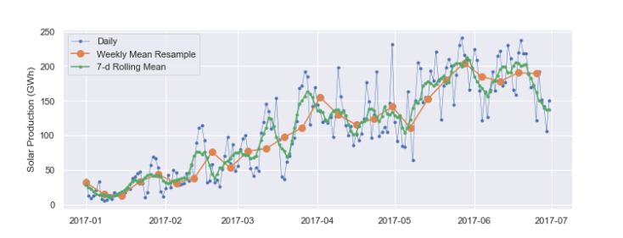
Implementation: Preprocessing
Load the dataset;
Manage categorical features;
Select the feature columns;
Create sequences (128 measurements per sequence);
Split into training and testing sequences;
Notes:
the difference between the previous algorithm is that there is no feature extraction or processing, but we simply clean the row data from the id columns and we translate the categorical features, so we create the sequences of data series and split the dataset

Slide 26
Implementation: Dataset wrapping
Create a subclass of the “Dataset” PyTorch class (SurfaceDataset) in order to wrap our training and testing sequences;
Create a subclass of the “LightningDataModule” PyTorch Lightning class (SurfaceDataModule) with methods to wrap the training and testing sequences into the “Dataset” subclass, and methods for returning the “DataLoader” of the training and testing sequences;
Once defined the batch size, we initialize the “data_module” object (instance of SurfaceDataModule) wrapping the dataset in order to use it with the PyTorch and PyTorch Lightning libraries;
Notes:
we wrap the dataset in order to use it for the training and testing phases with the pytorch library

Slide 27
Implementation: Model
Create a subclass of the PyTorch nn.module class (SequenceModel) where we define our networks:
LSTM network with an input layer of the number of neurons equal to the number of feature columns of our dataset and 3 hidden layers each with 256 neurons;
The output of the LSTM network goes into a linear classifier that outputs the predicted classes;
Create a subclass of the LightningModule class (SurfacePredictor) where we actually implement the model, the loss function (CrossEntropyLoss) and the Adam optimizer;
Notes:
we create the model that consist in a long short term memory network with an input layer size equal to the number of feature columns of our dataset and 3 hidden layers each with 256 neurons
The output of the Long Short Term Memory network goes into a linear classifier that outputs the predicted classes

Slide 28
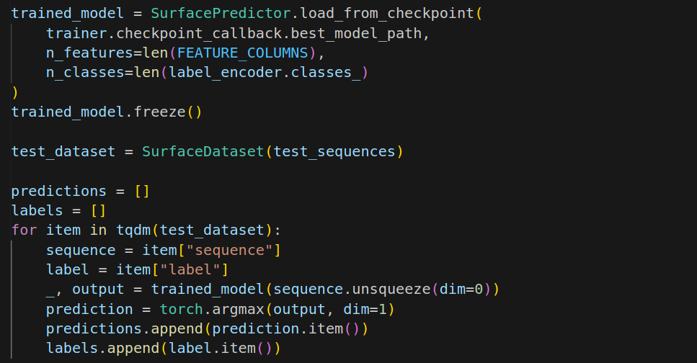
Implementation: Model
We define the “checkpoint_callback” (from PyTorch Lightning ModelCheckpoint): it saves the model’s checkpoint during training, allowing to save the best model based on a certain metric. In our case, it saves the checkpoint with the lowest validation loss.
We define a “trainer” (from PyTorch Lightning Trainer) where we define the maximum number of epochs, the checkpoint callback and the “CPU” for the training. We use this object for the training and testing phases.
Notes:
We define a checkpoint_callback that saves the model’s best parameters during training, based on a certain metric. In our case, it saves the checkpoint with the lowest validation loss.
so, after training, we can simply load the best parameters from the checkpoint and we have our model already trained
finally we create a trainer object and we use this object for the training and testing phases.

Slide 29
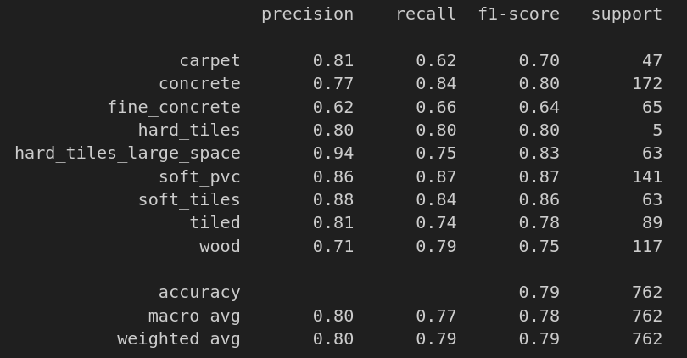
Implementation: Classification report
Notes:
This are the results with an accuracy of almost 80 per cent so we can make some conclusion from this results, taking into account the different choices in the two implementations

Slide 30
CONCLUSION:
COMPARISON & RESULTS
Notes:
To finish our presentation, we are going to comparing the results given by the two models.

Slide 31
Random Forest Vs Neural Network
Random Forest performances are better than Neural Network: Why?
Looking at the confusion matrices we notice that the neural network tends to classify classes with more data:
No feature extraction / processing;
Unbalanced data;
With some tweaks to the dataset, the accuracy of the neural network should be improved!
Running Time → RF 30 seconds Vs NN 4 minutes and 40 seconds
Accuracy → RF 91% Vs NN 79%
Notes:
Why Random Forest performances are better than Neural Network? Looking at the confusion matrices we notice that the neural network tends to classify classes with more data, this is related to the unbalanced data and to the fact that we do not perform feature extraction or processing on the dataset differently from our random forest algorithm, so with some tweaks to the dataset, the accuracy of the neural network should be improved!
- - -
We runned the two model on the same computer and how you can read there is big different between the computational time of our Random Forest program and the Neural Network. And the accuracies diversify for 10% more or less. We can concluded with a riflession about the preprocessing of the data. That process is an important part of machine learning because our best performance is due by that. Now, we are going to speak about the confusion matrix.

Slide 32
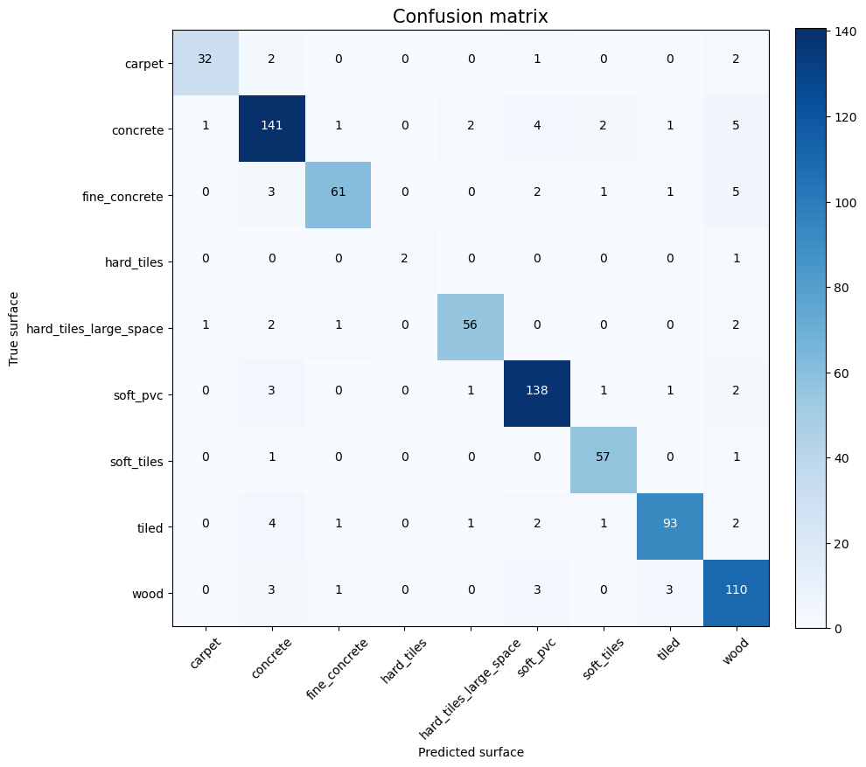
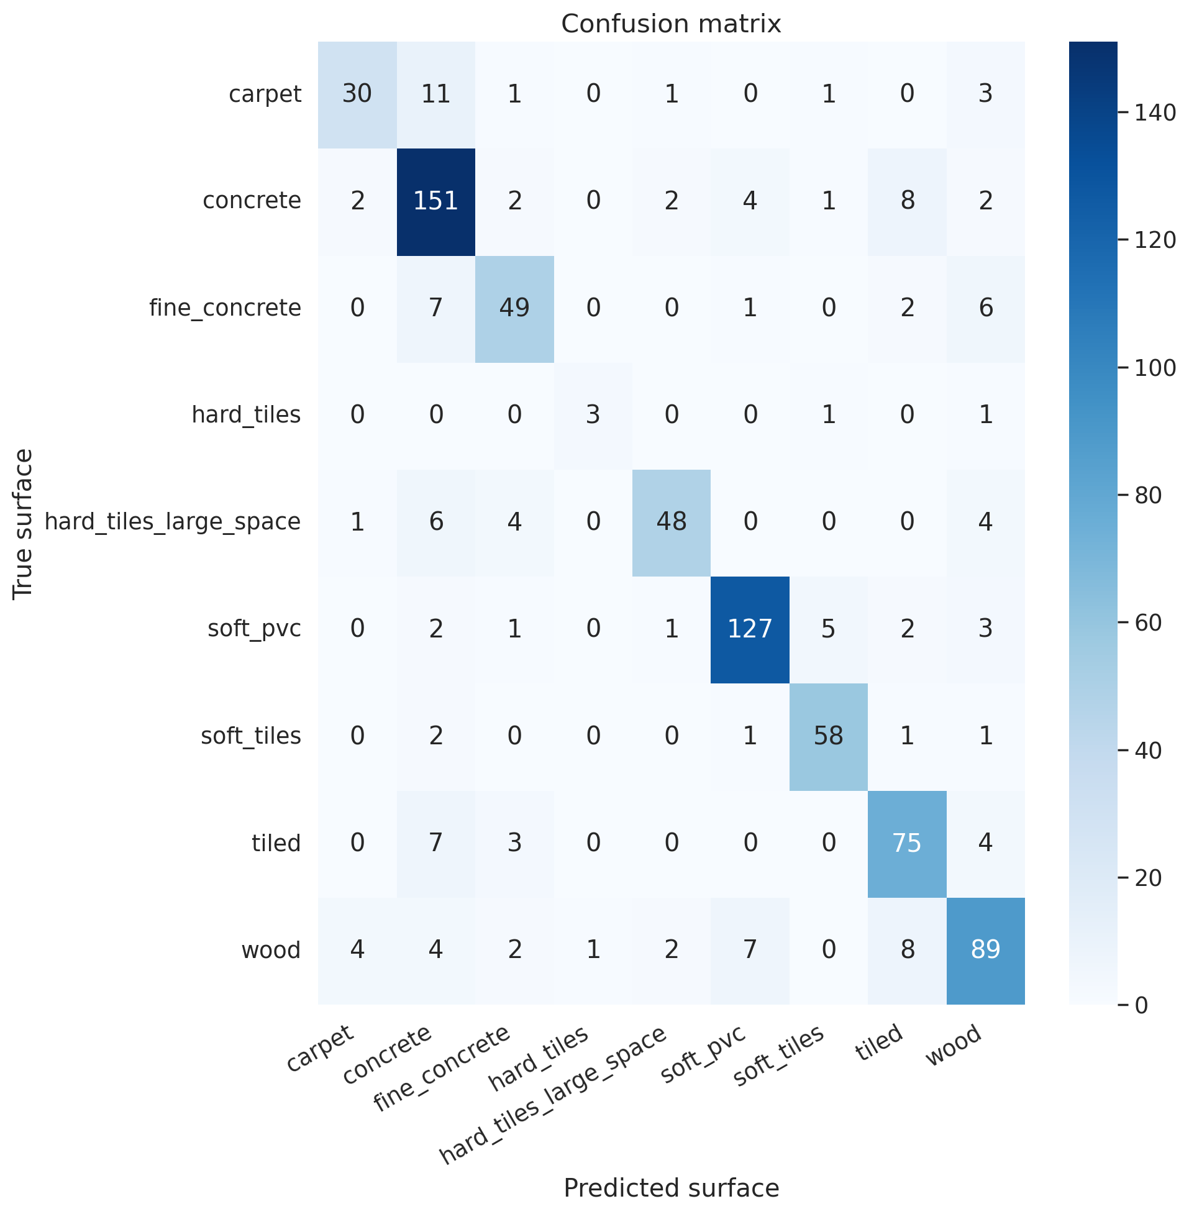
Random Forest Neural Network
Notes:
Upon examination of the results, it became evident that the RandomForestClassifier outperformed in accurately predicting surface classes. An interesting observation was made regarding classification errors, particularly for surfaces with a larger amount of data, such as concrete and wood when utilizing a neural network. This discrepancy raises the possibility of an underlying bias towards classes with more extensive datasets, as mentioned previously.
In conclusion, this analysis underscores the importance of meticulous pre-processing and handling of dataset imbalances to enhance the success of classification algorithms. It emphasizes the significance of understanding and addressing potential biases that may arise from variations in class sizes, ensuring a more robust and unbiased model.

Slide 33
Thank You For Listening
Demaria C. - Galvagni G. - Piacenti E.

